Slide 1


43th IG Meeting
South Gas Regional Initiative
23th May 2017
Teleconference

Slide 2
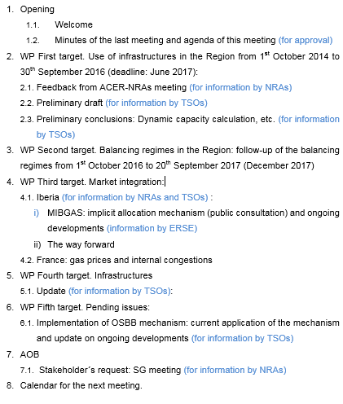
Agenda

Slide 3
2. WP First target: use of infrastructures in the Region (1st October 2014 to 30th September 2016)
  2.1 Feedback from ACER-NRAs meeting (for information by NRAs)
  ACER-NRAs held a telco meeting on 23rd of March to discuss how to address the SGRI WP in order to avoid overlapping, align conclusions and, in general, provide added value to ACER Implementation Monitoring Reports.
  Main conclusions of the meeting:
  WP Target 1 (use of infrastructures). NRAs were asked to:
      Check ENTSOG data on CAM/CMP data hub
      Analyse in depth those issues where IMR does not go deeply. ACER suggested three items: capacity calculation, bundling arrangements and secondary markets
      Share the methodology for calculating indicators to avoid overlapping and different conclusions due to the indicators use/definition (ACER provided NRAs with reports on CAM IMR, report on Congestion and CEPA study).
      Exchange early drafts and conclusions

Slide 4
2. WP First target: use of infrastructures in the Region (1st October 2014 to 30th September 2016)
  2.1 Feedback from ACER-NRAs meeting (for information by NRAs)
  WP Target 2 (balancing):
    NRAs were asked to:
      Check ENTSOG data on balancing hub
      CNMC and ERSE (SP and PT implemented the NC on 1st October 2016) will support ACER with data collection for the upcoming BAL IMR
      Potential for cross-border balancing will be studied
      Methodology to calculate indicators will be shared
      Exchange early drafts and conclusions
  Conclusions on target 1 and target 2 reports, to the extent necessary, will be aligned with ACER findings through the exchange of early drafts

Slide 5
2. WP First target: use of infrastructures in the Region (1st October 2014 to 30th September 2016)
2.2. Preliminary draft (for information by TSOs)
Assessment of the use of interconnections in the Region from the implementation of the Network Codes: from 1st October 2014 to 30th September 2016.
  Index
  The current situation of gas interconnections in the Region.
  The use of the gas interconnections.
  Assessment of the capacity allocated since the implementation of the CAM network code.
  Assessment of the gas flows and the congestion status.
  Recommendations.
  Conclusions
  Deliverable Deadline: June 2017

Slide 6
2. WP First target: use of infrastructures in the Region (1st October 2014 to 30th September 2016)
2.2. Preliminary draft (for information by TSOs)
TSOs will present a preliminary draft on the report on the use of the interconnections in the period 1st October 2014 to 30th September 2016 (deadline of the deliverable: June 2017).

Slide 7
2. WP First target: use of infrastructures
2.3. Results.
The report should give responses to several questions:
  Can be improved capacity calculation methodology?
  Is it possible to develop a joint dynamic capacity calculation methodology?
  Are agreements to get bundled capacity working?
  Secondary capacity market is working?
  Percentages for short term capacity reservation are working properly?
  What capacity products are more demanded?
  Are there congestions in the region?
  Is CMP working in a coordinated way?
  What CMP mechanism need to be reviewed?
  Which areas need a further coordination/cooperation between TSOs?
TSOs will share their preliminary findings

Slide 8
3. WP Second target: balancing
III.1 “Gas balancing regimes in SGRI”: Index (for information by NRAs)
  See 2.1 Feedback from ACER-NRAs meeting

Slide 9
3. WP Second target: balancing
III.1 “Gas balancing regimes in SGRI”: Index (for information by NRAs)

Slide 10
3. WP Second target: balancing
III.1 “Gas balancing regimes in SGRI”: Index (for information by NRAs)
  1. Subject matter. Brief description of the objective and scope of the study. (drafter: NRAs)
  2. Description of the balancing regimes in place (France, Spain and Portugal). (drafter: NRAs)
  3. Follow-up of the functioning of the balancing schemes since its application (1st October 2015 in France and 1st October 2016 in Portugal and Spain) to 30th September 2017. (drafter: TSOs)
  4. Conclusions and recommendations. (drafter: TSOs, NRAs)

Slide 11
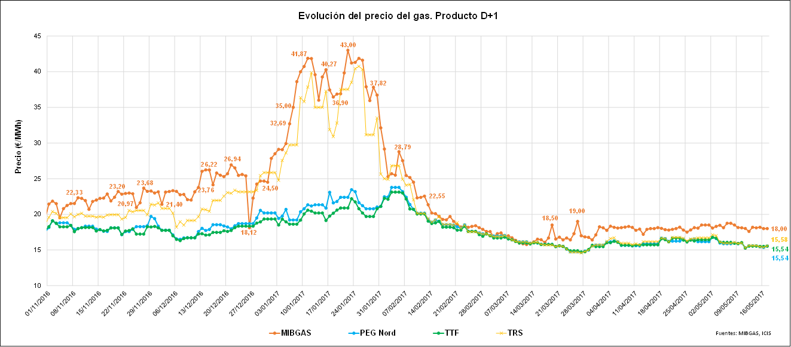
4. WP Third target: Market integration
  4.1. Iberia (for information by NRAs)
  Public consultation on implicit allocation mechanism in Portugal (for information by ERSE)
  4.2. France: gas prices and internal congestions (for information by NRAs and TSOs)
  Evolution of prices D+1 (1st November 2016- 16th May 2017)

Slide 12
4. WP Third target: Market integration

Slide 13
  5.1. Update on infrastructures development (for information by TSOs)
5. WP Fourth target: Infrastructures
  Progress on plans/projects for developing infrastructures
  (for information by TSOs)

Slide 14
6. WP Fifth target: Pending issues
  6.1. Implementation of OSBB mechanism: current application and ongoing developments (for information by TSOs)
  OSBB scheme was approved on April 2016.
  Implementation of OSBB mechanism:
    Manual mode: 1st April 2017 (VIP Ibérico)/ 1st October 2017 (VIP Pirineos)
    Fully automatic mode: 1st April 2018
  Description of current application at VIP Ibérico and interim mechanism envisaged at VIP Pirineos
  Ongoing developments to implement OSBB in fully coordinated and automatic mode at both VIPs

Slide 15
7. AOB
  Stakeholders´ request (EFET and Sedigas): SG meeting

Slide 16

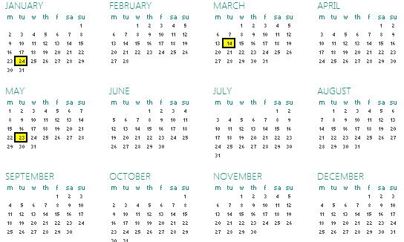
8. Calendar of the next meeting
Next meeting: Stakeholders Group SGRI: 26 or 29 or 30 of June 2017 (date tbd)

Slide 17
Thank you for your participation

